Slide 1

Anisocoria and Limited Eye Movements
UPFRONT CASE
Prem Subramanian, MD, PhD
Clifford R. and Janice N. Merrill Endowed Chair in Ophthalmology
Professor of Ophthalmology, Neurology, and Neurosurgery
Sue Anschutz-Rodgers Eye Center
University of Colorado School of Medicine
Dhruva (Drew) Gupta, BS
M4 Medical Student
Harvard Medical School
Notes:
Hello! My name is Drew Gupta, and I am a fourth-year medical student at Harvard. Along with Dr. Prem Subramanian, who is the Clifford and Janice Merrill Endowed Chair in Ophthalmology at the University of Colorado School of Medicine, we are here to present an UPFRONT Case on a patient with anisocoria and limited eye movements.​

Slide 2
46-Year-Old Woman with Anisocoria and Limited Eye Movements
History
  Previously healthy 46-year-old female brought to the emergency department (ED) after loss of consciousness and seizure-like activity following closed head trauma
  Found to have anisocoria and limited extraocular movements (EOM), which prompted ophthalmology consultation
Notes:
Our patient presented to the ED of an outside hospital after falling off her horse during a competition. ​
​
After the fall, she immediately experienced loss of conscious and seizure-like activity.​
​
Because of a dilated right pupil and limited extraocular movements (EOM), ophthalmology was consulted to see her​
​
Our patient endorsed headache, photophobia in both eyes, and mild blurry vision in the right eye. She also described an “inability of the eyes to work together”.​
​
For negative review of systems, she did not report double vision, eye pain, pain with eye movements, or nausea/vomiting.​
​
She does not have any relevant past medical, surgical, ocular, family, or social history.

Slide 3
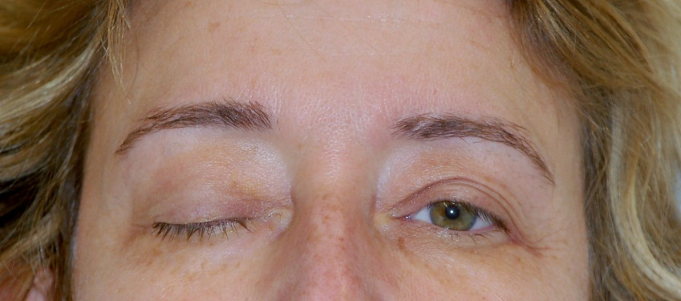
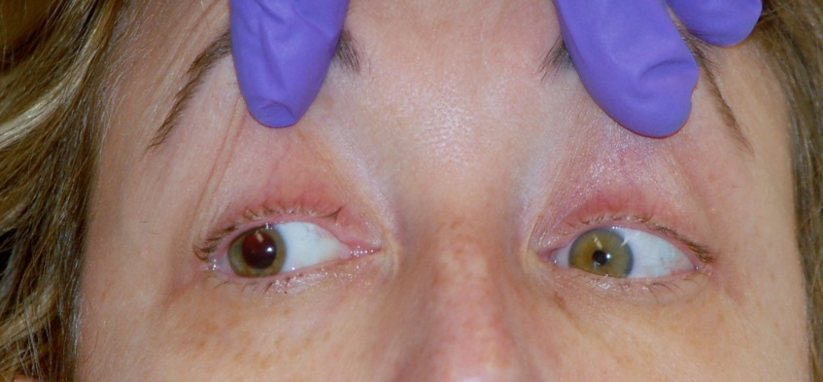
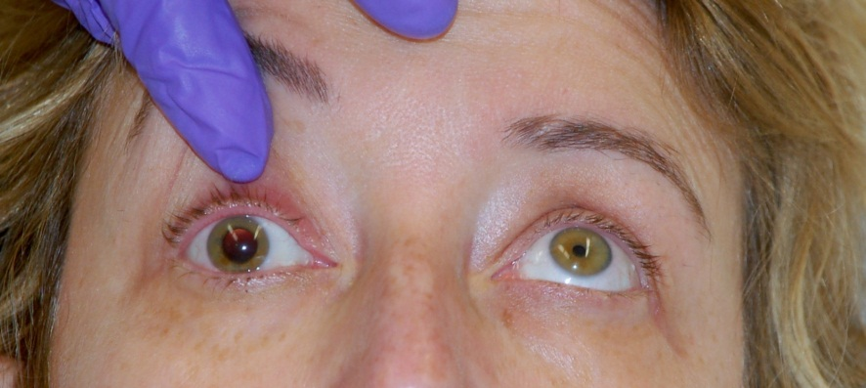
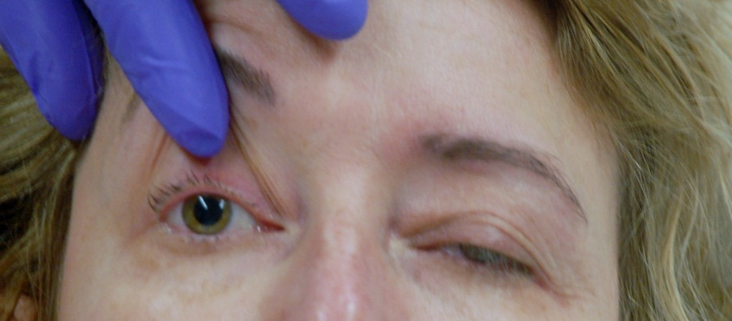
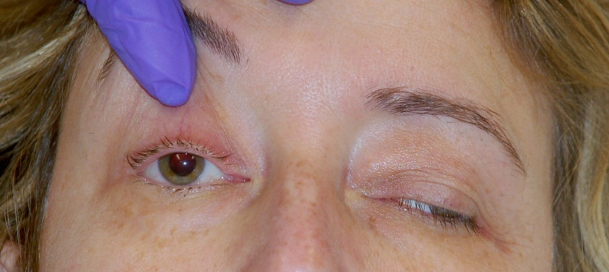
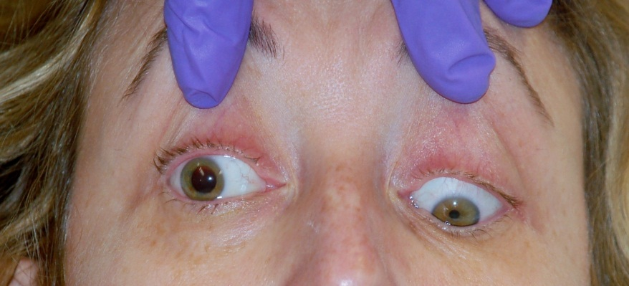
46-Year-Old Woman with Anisocoria and Limited Eye Movements
Examination
Notes:
Here you can see the extraocular movements for this patient. ​
​
All the way on the left panel, the upper image demonstrates the patient looking forward, while the lower image reveals the patient’s right pupil to be much larger than the left.​
​
In the middle panel, the upper image demonstrates the patient’s gaze towards her right, while the lower image shows the patient’s gaze towards her left. Right eye abduction is normal, while adduction is absent. The left eye moves normally.​
​
In the right panel, the upper image shows patient’s gaze upwards, while the lower image shows the patient’s gaze downwards. Almost no elevation or depression occurs on the right, while the left eye remains normal.​

Slide 4
46-Year-Old Woman with Anisocoria and Limited Eye Movements
  Examination
  EOM:
    OD: - 4 elevation, depression, and adduction deficits
    OS: wnl
  Pupils:
    OD: 7 7
    OS: 3 2
    OU: No RAPD
  External/LLL
    OD: Complete ptosis
    OS: wnl
Based on these physical exam findings, which cranial nerve is likely affected?
Notes:
Her physical exam was notable for deficits of elevation, depression, and adduction in just her right eye. Abduction was preserved.​
​
Her right pupil did not constrict to light, while her left pupil did.​
​
She also had ptosis in the right eye, but the left eye was normal.​
​
Based on the images from the prior slides and the exam findings listed here, which cranial nerve has likely been affected?

Slide 5
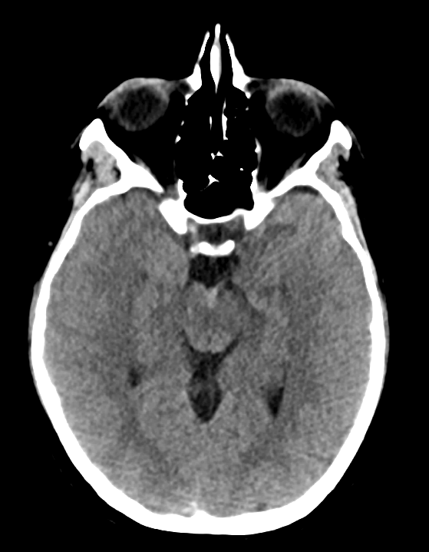
46-Year-Old Woman with Anisocoria and Limited Eye Movements
What abnormality do you see?
Notes:
Here is the CT Head that was obtained. What abnormality do you see here?

Slide 6
46-Year-Old Woman with Anisocoria and Limited Eye Movements
  Imaging
  CT Head: Focal hemorrhage in right CN III when emerging from brainstem.
  CTA: no evidence of aneurysms
Notes:
If you look where the arrow is pointing, you can see a focal hemorrhage in the right CN III as it emerges from the brainstem
Of note, the CT angiography did NOT reveal any evidence of aneurysms

Slide 7
46-Year-Old Woman with Anisocoria and Limited Eye Movements
  Differential Diagnosis for isolated CN III Palsy
  Microvascular
  Trauma
  Hemorrhage
  Aneurysm
  Neoplasm
  Infection
  Inflammation
Notes:
When presented with isolated CN III palsy, the differential diagnosis to consider includes microvascular ischemia, trauma, hemorrhage, aneurysm, tumor, infection, and inflammation. Let’s review these to see which one applies to our patient.​
​
Microvascular ischemia is the most common etiology. However, this was not likely the cause given that the patient was only 46 years old had an absence of risk factors such as diabetes, hypertension, or hyperlipidemia.​
​
Aneurysm is another common cause, but there was no evidence of aneurysms on CTA. Third nerve compression due to hemorrhage could be plausible, but the CTA only showed a minimal amount of subarachnoid hemorrhage and there was no mass effect.​
​
There was no sign of proptosis, periorbital swelling, or loss of vision to suggest orbital infection or inflammation, and she had no other neurological symptoms to suggest intracranial infection. ​
​
There was no evidence of imaging to suggest a neoplasm.​
​
The most likely cause of CN3 palsy in this case was trauma.​

Slide 8
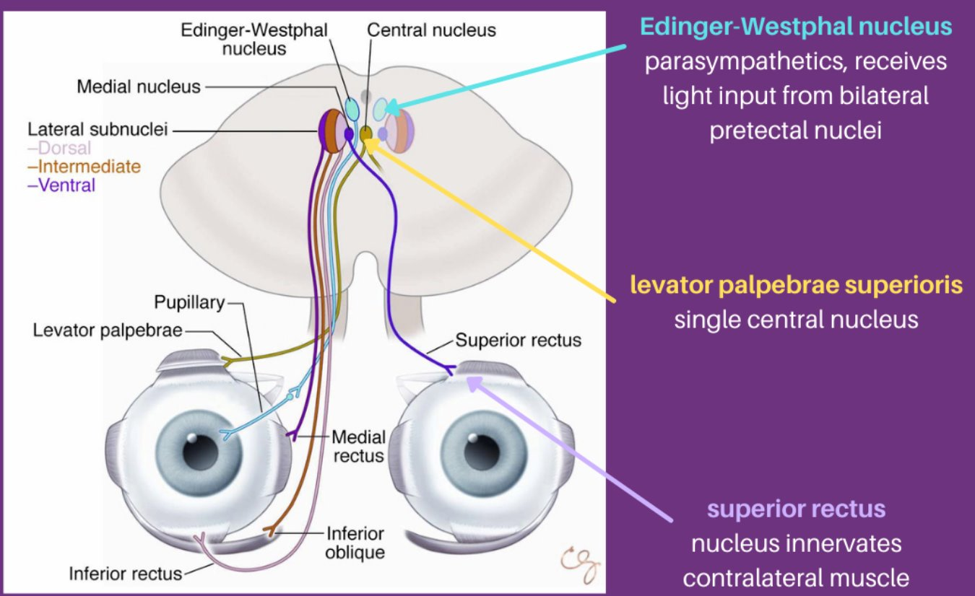
Pathway of CN III
American Academy of Ophthalmology/Ophthalmology Review
Notes:
This slide illustrates the complex pathway of CN III and its subdivisions within the midbrain. The central nucleus of CN III controls the levator palpebrae superioris muscle, which elevates the eyelid. The medial subnucleus innervates the contralateral superior rectus muscle, facilitating upward gaze.​
​
The lateral subnuclei are responsible for innervating the remaining extraocular muscles of CNIII: the dorsal subnucleus controls the inferior rectus (facilitating downward gaze), the intermediate subnucleus controls the inferior oblique (facilitating extorsion and elevation), and the ventral subnucleus controls the medial rectus (facilitating adduction of the eye).​
​
The Edinger-Westphal nucleus houses the parasympathetic fibers that project to the pupillary sphincter muscle (which induces constriction), and to the ciliary muscle (which adjusts the lens curvature for accommodation). These parasympathetic fibers are crucial for pupillary response to light and for near vision focus.​

Slide 9
Mechanisms of Injury
Direct shearing injury due to partial avulsion as CN III exits the midbrain
Direct traction injury due to nerve stretching against posterior petroclinoid ligament
Direct vascular compression due to internal carotid artery dissection and aneurysm
Indirect injury caused by impaired blood supply to CN III
Notes:
Mechanisms for CN3 palsy from trauma include direct shearing injury due to partial avulsion as CN3 exits the midbrain, direct traction injury as CN3 stretches against the petroclinoid ligament due to downward displacement of the brainstem, direct vascular compression due to dissection or aneurysm, and indirect injury caused by impaired blood supply.​
​
For our patient, either mechanism 1 or 2 is the most likely phenomenon for CN3 palsy. Mechanisms 3 and 4 are less likely due to a normal CTA.​

Slide 10
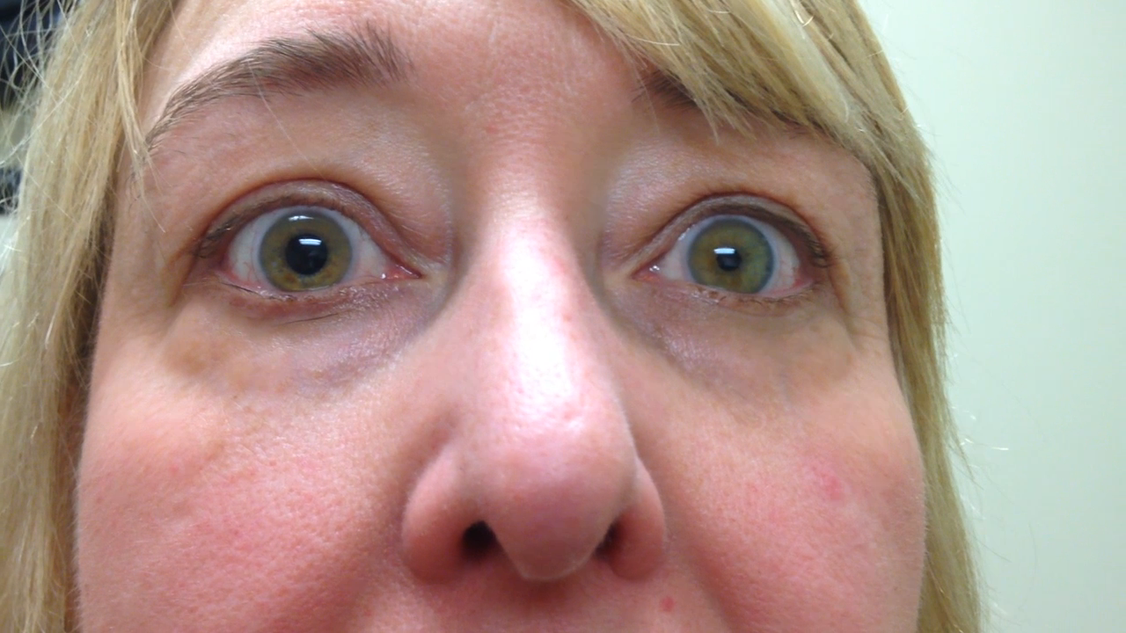
Follow-Up Visit #1 (Video)
Notes:
This is a video of the patient’s EOM. See what you think, and we will discuss more in the following slides.

Slide 11
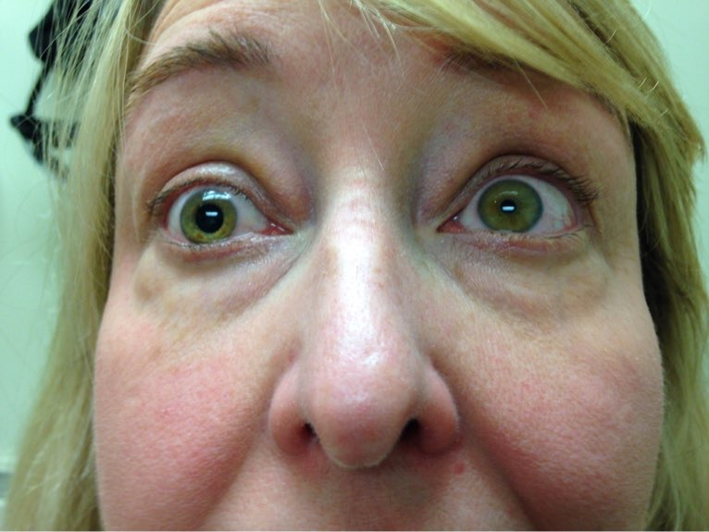
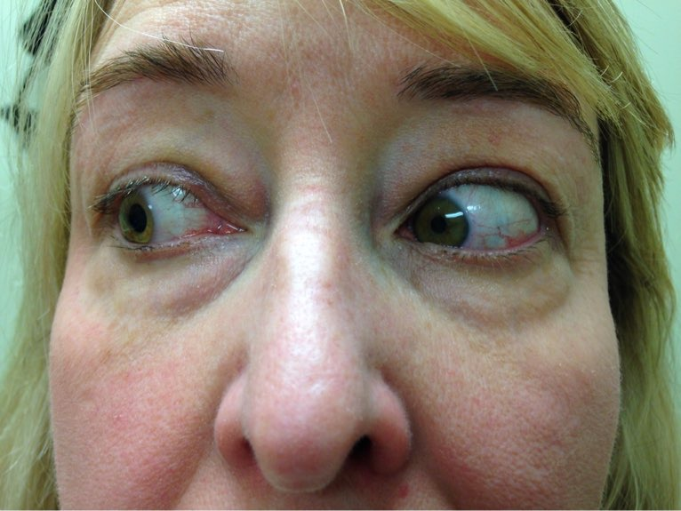
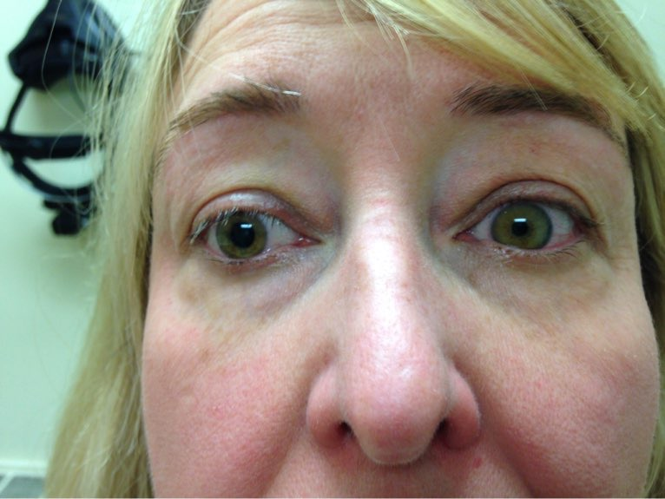
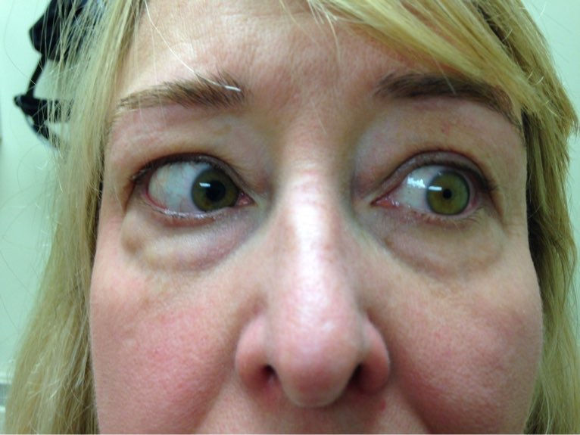
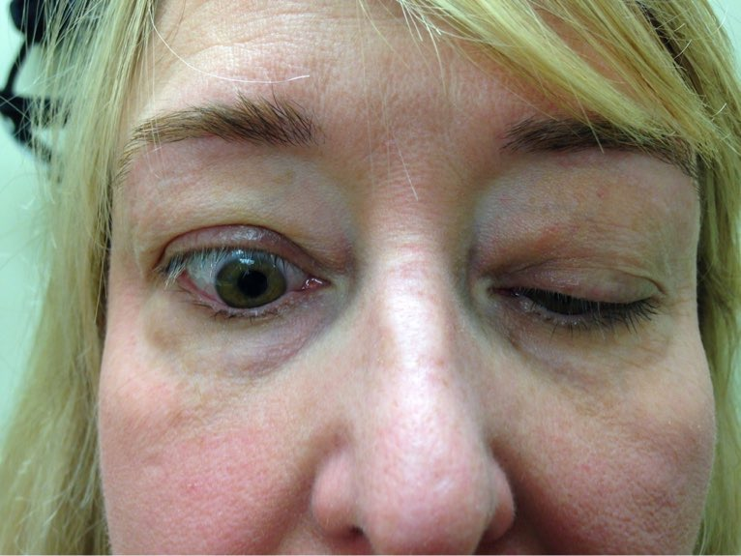
Follow-Up Visit #1 (Images)
What do you call this phenomenon?
Notes:
Here are some of the notable highlights from the video. As seen from these images, patient has improvement in eye movements compared to her initial incident. ​
​
Please note the bottom image in the middle panel, which shows a reversal of ptosis in the R eyelid as the patient looks downward. What would you call this phenomenon?​

Slide 12
Follow-Up Visit #1
3.5 months from the initial incident (Sept 2014)
  Accommodation: Continued loss of accommodation
  Mydriasis: Continued to have dilated pupil
  Ptosis: Lid fissure 7 mm (normal 9-11 mm)
  Aberrant regeneration: Reversal of ptosis upon downgaze
  Diplopia: Improvement in EOMs. Able to fuse (with effort) when looking down and to the right
Notes:
At her follow-up visit 3.5 months after the incident, our patient still had deficits expected from CN3 palsy. She had trouble with:​
​
-accommodation due to impaired function of ciliary muscles​
-continued mydriasis due to impaired function of pupillary constrictor muscles​
-ptosis with a lid fissure of 7mm​
-aberrant regeneration that caused CN3 nerve to lift the upper eyelid upon downgaze​
-diplopia that improved since the initial incident due to more motile extraocular movements. Out was able to fuse when looking down and to the right.

Slide 13
Follow-Up Visit #2
10 months from the initial incident (March 2015)
  Accommodation: Partial recovery of accommodation
  Mydriasis: Prescribed brimonidine
  Ptosis: Stable
  Aberrant regeneration: Stable
  Diplopia: EOM markedly improved. Intermittent exotropia in primary gaze, was able to fuse
Notes:
At her second follow-up visit, 10 months after the initial incident, her accommodation had some recovery with evidence of tonic contraction of the pupil when viewing nearby objects. She was prescribed brimonidone for mydriasis. Her ptosis was stable, her aberrant regeneration was stable, and her diplopia continued to improve with only intermittent exotropia.​
​
Please note that pilocarpine, while a cholinergic medication that can help with mydriasis, can predispose a patient at risk for retinal detachment, especially if they have lattice degeneration like our patient.

Slide 14
Follow-Up Visit #3
3 years from the initial incident (April 2018)
  Accommodation: Stable
  Mydriasis: Slightly improved
  Ptosis: Stable
  Aberrant Regeneration: Slightly improved
  Diplopia: Stable right hypotropia and intermittent exotropia. Managed with prism glasses
Notes:
In her third visit, about 3 years from the initial incident, accommodation was stable, mydriasis had slightly improved as her pupil was only dilated to 5mm (as opposed to 7mm from before), ptosis was stable, her aberrant regeneration partially healed, and her diplopia was stable with prism glasses.​
​
However, because the prism glasses made it difficult to continue her passion for horseback riding, she was given the option of strabismus surgery, which she ultimately pursued.​

Slide 15
Strabismus Surgery
  Patient had a recession procedure for the right lateral and inferior rectus muscles in August 2018.
  At 6 months follow-up, she reported minimal diplopia. On exam, she had good range of fusion and minimal latent strabismus in primary gaze.
Notes:
Our patient had her strabismus surgery performed on August 2018, in which she had a recession procedure for the right lateral and inferior rectus muscles.​
​
At her six-month follow-up after the operation, her diplopia had improved. Her exam showed good range of fusion and minimal diplopia.
At her six-month follow-up after the operation, her diplopia had improved. Her exam showed good range of fusion and minimal diplopia.

Slide 16
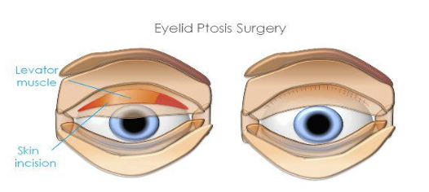
Ptosis Surgery
Patient had RUL ptosis repair in May 2019
Image from https://www.theestheticclinic.com/reconstructive/eyelid-disease/eyelid-ptosis-surgery.html
Notes:
In May 2019, patient had ptosis surgery performed to repair the right upper eyelid. Essentially, surgeons were able to make an incision through the skin and then tighten the levator muscle.​
​
Please note that ptosis surgery was performed AFTER strabismus surgery given that ptosis could have changed after a strabismus operation on a vertical rectus muscle.

Slide 17
Factors Affecting Recovery
Notes:
Let’s now discuss the factors that affect recovery in CN III palsy due to trauma

Slide 18
Recovery of CN III Palsy in Trauma
One study found that patients with CN III palsy due to trauma experienced a recovery rate of 40%, while patients with CN III palsy due to either aneurysm or neoplasm experienced recovery rates of 0% and 40%, respectively (Akagi et al, 2008)
Of patients with head trauma and cranial nerve palsy (either 3, 4 or 6) who had proper follow-up, 87.5% healed completely while 12.5% healed partially, surpassing the recovery rates of other causes (Park et al, 2008).
Based on these studies, CN III palsy from trauma demonstrated similar or better recovery rates compared to CN III palsy from other causes.
Notes:
The studies cited here demonstrate that for cases of CN3 palsy due to trauma, the rate of recovery was similar or better compared to other causes of CN3 palsy, such as aneurysms or neoplasms.
Recovery was defined as improvement in deviation angle and/or ocular motility. In our case, the patient had a better prognosis given her CN3 palsy was due to trauma.

Slide 19
Rates of Symptom Improvement
Of 13 patients with CN III palsy and internal ophthalmoplegia, only one had resolution of symptoms (Park et al, 2008). In another study, 13 (50%) of 26 patients with internal ophthalmoplegia had symptomatic recovery (Lin et al, 2013).
Twelve (80%) of the 15 patients with CN III palsy who had proper follow-up showed recovery of ptosis (Park et al, 2008). In another study, 19 (95%) of 20 patients with ptosis experienced recovery long-term (Lin et al, 2013).
Ptosis has a higher chance of improvement compared to internal ophthalmoplegia.
Notes:
Based on multiple studies, ptosis is more likely to resolve on its own compared to symptoms from internal ophthalmoplegia. In our case, surgical correction for ptosis was performed after four years of spontaneous recovery
Additionally, she initially showed partial but not complete improvement with accommodation and mydriasis, which is to be expected with internal ophthalmoplegia.

Slide 20
Deviation Angle Associated with Recovery
In comparison between the patients with and without complete recovery, no significant differences were found in the gender, average onset age, palsied nerve, etiology and ocular motor restriction (Park et al, 2008)
Only deviation angle on first visit (P=0.007) showed a significant association with recovery (Park et al, 2008; Holmes, Leske, and Christiansen, 2001).
Notes:
In the literature, the only factor associated with likelihood of recovery was the deviation angle in the first visit. It did not depend on age of onset, etiology, or ocular motor restriction.

Slide 21
Skull Base Fractures and Recovery
A CN deficit (including CN III palsy) was present in 26 (81.2%) of the 32 cases with a skull base fracture, 12 (60%) of 20 cases with other CT abnormalities, and 3 (30%) of 10 cases without CT abnormalities one year after head trauma (Coello et al, 2010).
Of the three patients with a skull base fracture and CN III palsy, none had a complete recovery. In contrast, all four patients with a CN III palsy and a CT abnormality other than a skull base fracture completely recovered from the deficit (p=0.029) (Coello et al, 2010).
Notes:
A skull base fracture is a poor outcome for recovery of CN3 palsy. Luckily, our patient was wearing a helmet during the incident and did not have any evidence of fractures on CT.

Slide 22
Additional Teaching Point
For cases of CN III palsy (or other cranial nerves) caused by mild head trauma, always check imaging (i.e. CT angiography) for aneurysms or masses.
While possible for CN III palsy to occur just due to mild head trauma, it is considered a rare event
Notes:
Before we end, I wanted to mention one more teaching point: For cases of CN3 palsy (or other cranial nerves) caused by mild head trauma, always check imaging (i.e. CT angiography) for aneurysms or masses.
While CN3 palsy from mild head trauma is possible, it is rare. Therefore be sure to double-check with additional imaging to identify another underlying cause if present.

Slide 23
Summary
For isolated CN III palsy, trauma is a common etiology with the highest rate of recovery
Findings include internal ophthalmoplegia (loss of accommodation, mydriasis) and external ophthalmoplegia (diplopia, ptosis, reduced eye movement)
Internal ophthalmoplegia have higher rates of recovery compared to external ophthalmoplegia
Order imaging to ensure absence of aneurysm or mass, especially in cases of mild head injury
Initial deviation angle is the only factor associated with recovery, while skull base fractures have a poor prognosis
Notes:
Here is our summary slide where you can find the main highlights from this presentation. We appreciate your time, and thank you for listening.

Slide 24
References
Akagi, Tadamichi, Kazuaki Miyamoto, Satoshi Kashii, and Nagahisa Yoshimura. 2008. “Cause and Prognosis of Neurologically Isolated Third, Fourth, or Sixth Cranial Nerve Dysfunction in Cases of Oculomotor Palsy.” Japanese Journal of Ophthalmology 52 (1): 32–35.
Chen, C-C, Y-M Pai, R-F Wang, T-L Wang, and C-F Chong. 2005. “Isolated Oculomotor Nerve Palsy from Minor Head Trauma.” British Journal of Sports Medicine 39 (8): e34.
Chen, Chien-Tzung, Theresa Y. Wang, Pei-Kwei Tsay, Faye Huang, Jui-Pin Lai, and Yu-Ray Chen. 2010. “Traumatic Superior Orbital Fissure Syndrome: Assessment of Cranial Nerve Recovery in 33 Cases.” Plastic and Reconstructive Surgery 126 (1): 205–12.
Coello, Alejandro Fernández, Andreu Gabarrós Canals, Juan Martino Gonzalez, and Juan José Acebes Martín. 2010. “Cranial Nerve Injury after Minor Head Trauma.” Journal of Neurosurgery 113 (3): 547–55.
Cui, Victoria, and Timur Kouliev. 2016. “Isolated Oculomotor Nerve Palsy Resulting from Acute Traumatic Tentorial Subdural Hematoma.” Open Access Emergency Medicine: OAEM 8 (October): 97–101.
Dhaliwal, Avninder, Adrienne L. West, Jonathan D. Trobe, and David C. Musch. 2006. “Third, Fourth, and Sixth Cranial Nerve Palsies Following Closed Head Injury.” Journal of Neuro-Ophthalmology: The Official Journal of the North American Neuro-Ophthalmology Society 26 (1): 4–10.
Elston, J. S. 1984. “Traumatic Third Nerve Palsy.” The British Journal of Ophthalmology 68 (8): 538–43.
Erenler, Ali Kemal, Anıl Yalçın, and Ahmet Baydin. 2015. “Isolated Unilateral Oculomotor Nerve Palsy due to Head Trauma.” Asian Journal of Neurosurgery 10 (3): 265–67.
Fang, Chengbo, Jacqueline A. Leavitt, David O. Hodge, Jonathan M. Holmes, Brian G. Mohney, and John J. Chen. 2017. “Incidence and Etiologies of Acquired Third Nerve Palsy Using a Population-Based Method.” JAMA Ophthalmology 135 (1): 23–28.
Gupta, Praveen Kumar, Mohammad Arif, Likhita Shaik, Romil Singh, and Kaushal Shah. 2020. “Solitary Sign of Third Nerve Palsy in a Conscious Patient With Epidural Hemorrhage.” Cureus 12 (8): e10003.
Kaido, Takanobu, Yoshihiro Tanaka, Yukihide Kanemoto, Yoshiaki Katsuragi, and Hisakazu Okura. 2006. “Traumatic Oculomotor Nerve Palsy.” Journal of Clinical Neuroscience: Official Journal of the Neurosurgical Society of Australasia 13 (8): 852–55.
Keane, James R. 2010. “Third Nerve Palsy: Analysis of 1400 Personally-Examined Inpatients.” The Canadian Journal of Neurological Sciences. Le Journal Canadien Des Sciences Neurologiques 37 (5): 662–70.
Kim, Taeyeon, Kiyeun Nam, and Bum Sun Kwon. 2020. “Isolated Oculomotor Nerve Palsy in Mild Traumatic Brain Injury.” American Journal of Physical Medicine & Rehabilitation / Association of Academic Physiatrists 99 (5): 430–35.
Kuo, Lu-Ting, Abel Po-Hao Huang, Chi-Cheng Yang, Shao-Yu Tsai, Yong-Kwang Tu, and Sheng-Jean Huang. 2010. “Clinical Outcome of Mild Head Injury with Isolated Oculomotor Nerve Palsy.” Journal of Neurotrauma 27 (11): 1959–64.
Levy, Richard L., Craig E. Geist, and Neil R. Miller. 2005. “Isolated Oculomotor Palsy Following Minor Head Trauma.” Neurology 65 (1): 169.
Lin, Chao, Yan Dong, Liquan Lv, Mingkun Yu, and Lijun Hou. 2013. “Clinical Features and Functional Recovery of Traumatic Isolated Oculomotor Nerve Palsy in Mild Head Injury with Sphenoid Fracture.” Journal of Neurosurgery 118 (2): 364–69.
Liu, Yo-Tsen, Yi-Chung Lee, and Hsiu-Chih Liu. 2004. “Isolated Oculomotor Nerve Palsy due to Head Injury.” Journal of the Chinese Medical Association: JCMA 67 (3): 149–51.
Muthu, P., and P. Pritty. 2001. “Mild Head Injury with Isolated Third Nerve Palsy.” Emergency Medicine Journal: EMJ 18 (4): 310–11.
Park, U-C, S-J Kim, J-M Hwang, and Y. S. Yu. 2008. “Clinical Features and Natural History of Acquired Third, Fourth, and Sixth Cranial Nerve Palsy.” Eye 22 (5): 691–96.
Sartoretti, Thomas, Elisabeth Sartoretti, Christoph Binkert, David Czell, and Sabine Sartoretti-Schefer. 2017. “Intraneural Hemorrhage in Traumatic Oculomotor Nerve Palsy.” Radiology Case Reports 12 (1): 150–53.
Takeuchi Satoru, Takasato Yoshio, Masaoka Hiroyuki, Hayakawa Takanori, Otani Naoki, Yoshino Yoshikazu, and Yatsushige Hiroshi. 2008. “Isolated traumatic oculomotor nerve palsy caused by minor head trauma.” Brain and nerve = Shinkei kenkyu no shinpo 60 (5): 555–58.
Tamhankar, Madhura A., Valerie Biousse, Gui-Shuang Ying, Sashank Prasad, Prem S. Subramanian, Michael S. Lee, Eric Eggenberger, et al. 2013. “Isolated Third, Fourth, and Sixth Cranial Nerve Palsies from Presumed Microvascular versus Other Causes: A Prospective Study.” Ophthalmology 120 (11): 2264–69.
Uberti, Micaela, Shumaila Hasan, David Holmes, Mario Ganau, and Chris Uff. 2021. “Clinical Significance of Isolated Third Cranial Nerve Palsy in Traumatic Brain Injury: A Detailed Description of Four Different Mechanisms of Injury through the Analysis of Our Case Series and Review of the Literature.” Emergency Medicine International 2021 (April): 5550371.
Volker, Joseph H. 2018. “Oculomotor Nerve.” Earth’s Lab. August 8, 2018. https://www.earthslab.com/anatomy/oculomotor-nerve/.
Wang, Anqi, Mian Wang, Yanqiao Wu, Yifan Zhao, Zhimin Wang, and Likui Shen. 2022. “Traumatic Oculomotor Nerve Palsy Treated with Transnasal Endoscopic Decompression through the Optic Strut.” Frontiers in Surgery 9: 1051354

